Slide 1
Signals and Systems
Lecturer:
Dr. Bin Xia
Dept. of Electronic Engineering
Shanghai Jiao Tong University
Chapter 2: Linear Time-Invariant Systems

Slide 2
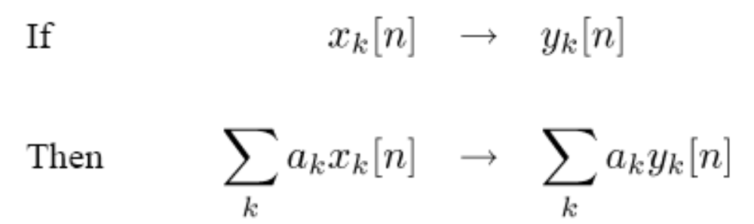
Foreword of the Chapter
By exploiting the properties of superposition and time invariance, if we know the response of an LTI system to some inputs, we actually know the response to many inputs
If we can find sets of “basic” signals so that
  We can represent rich classes of signals as linear combinations of these building block signals.
  The response of LTI Systems to these basic signals are both simple and insightful.

Slide 3


Candidate sets of basic signal
  Unit impulse function and its delays
  Complex exponential/sinusoid signals, in chapters 3~5
In this Chapter, we will focus on
  Characterizing LTI systems in terms of its response to a unit impulse: convolution sum in DT, and convolution integral in CT -> Examine some other properties of LTI systems
  Representing LTI systems in terms of linear differential equations in CT domain and its discrete-time counterpart, i.e. difference equations -> Develop tools to solve the equations

Slide 4
Outline of the Chapter
2.1 DT LTI Systems: the Convolution Sum
2.2 CT LTI Systems: the Convolution Integral
2.3 Properties of LTI Systems
2.4 Casual LTI Systems in terms of
Differential/Difference Equations
2.5 Singularity Functions

Slide 5
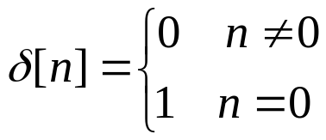


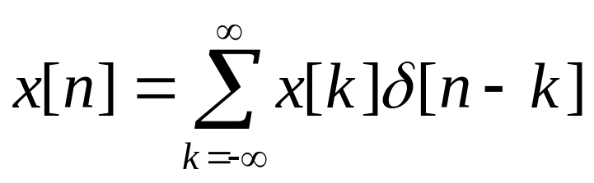
2.1.1 The Representation of Discrete-Time Signals in Terms of Impulses
Recall the definition of the unit impulse function and the sampling property of the DT unit impulse function that
one obtains
in general,
Basic Signals
x[n] could be represented by a linear combination of shifted unit impulse δ[n-k], with weights of x[k]

Slide 6


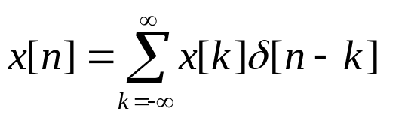
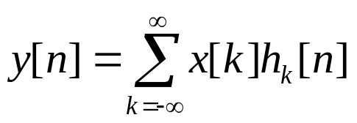
2.1.2 Convolution-Sum Representation of LTI Systems
  1. For a linear system with the response of h_{k}[n] to the unit impulse δ[n-k]
—— Unit Impulse Response
Considering the weighted sum of delayed impulse representation of x[n]
Superposition allows
——Convolution Sum

Slide 7



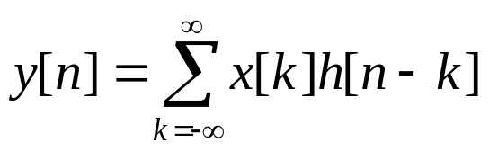
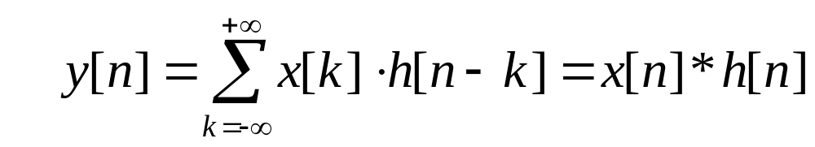
  2. For a LTI system with the response of h[n] to the unit impulse δ[n]
—— Unit Impulse Response
Time-invariance allows
Considering the weighted sum of delayed impulse representation of x[n]
Superposition allows
——Convolution Sum
That is

Slide 8
Observations
A DT signal could be represented as a linear combination of delayed impulses, weighted by x[k] for the delayed impulse of δ[n-k] .
The response y[n] of an LTI system with an DT input signal x[n] is the weighted linear combination of delayed impulse response, weighted by x[k] for the delayed impulse response of h[n-k].
An LTI system is completely characterized by its response to the unit impulse ---- h[n]

Slide 9
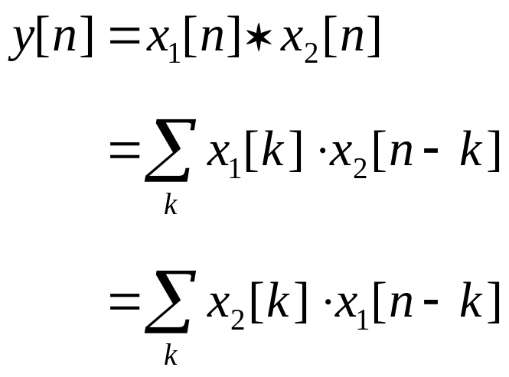
2. Convolution Sum

Slide 10
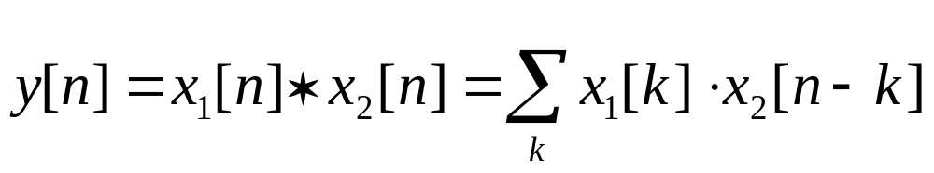
Method 1. Visualizing the calculation of convolution sum graphically
Step 1. Replace n with k for signals x₁[n] and x₂[n], i.e. k is the independent variable
Flip
x₂[k] -> x₂[-k]
Step 2. Obtain the time reversal of x₂[k]
Step 3. For the output value at any specific time n, shift x₂[-k] with offset n to obtain x₂[n-k]
Shift
x₂[-k] -> x₂[n-k]
Step 4. Multiply the two sequences x₁[k] and x₂[n-k] obtained in Step 1 and Step 3, respectively, and sum all the samples in the multiplied sequence
Multiply
x₁[k]x₂[n-k]
Sum

Slide 11
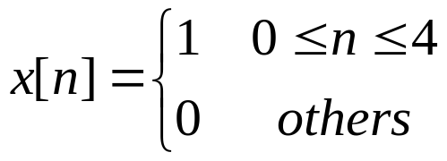
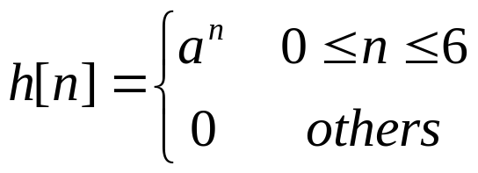

Example：
x[n]
Let
0
1
2
3
4
n
h[n]
Determine
0
1
6
n

Slide 12
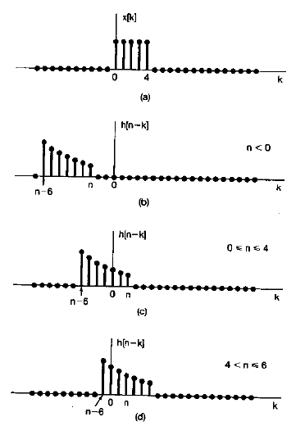
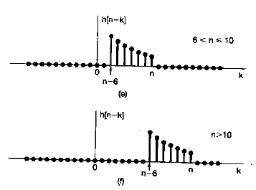
1. View as functions of k with n fixed
2. Calculating Successive Values: Shift, Multiply, Sum

Slide 13
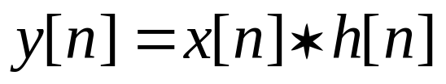
Method 2. Analytical Approach
Example:
Let
Determine

Slide 14
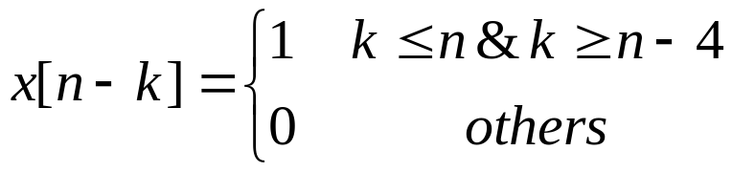
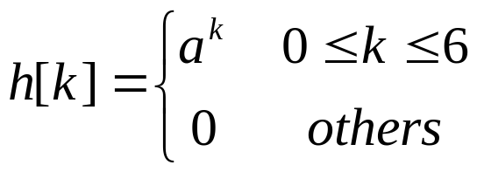
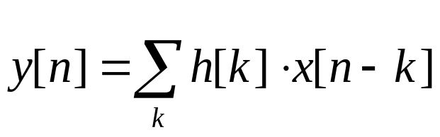
Solution: since
Using the convolution sum equation
One calculates the convolution sum for n belongs to different regions (-∞, 0], [0, 4], [4, 6], [6, 10], [10, ∞)

Slide 15
Method 3. To exploit the property of δ[n] to calculation the convolution sum
Details will be presented later after the study on the properties of convolution and DT LTI systems

Slide 16
2.1.3 Properties of convolution and DT LTI systems. We will focus on
  Understanding the corresponding physical concept of LTI systems to each property of convolution operation;
  Simplifying the convolution calculation by exploiting the properties of these properties of convolution operation

Slide 17

1. The Commutative Property（交换律 ）
h[n]
x[n]
y[n]
using the definition of convolution sum
=
x[n]
h[n]
y[n]

Slide 18
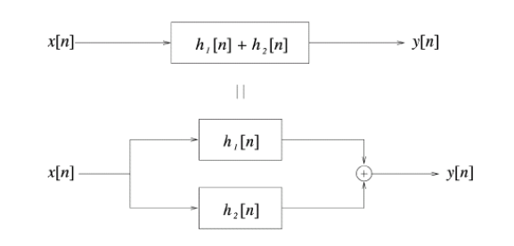
2. The Distributive Property（分配律 ）
using the definition of impulse response
Notes:
重新画图！

Slide 19
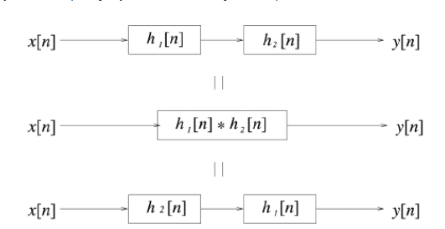
3. The Associative Property （结合律 ）
using the definition of impulse response

Slide 20
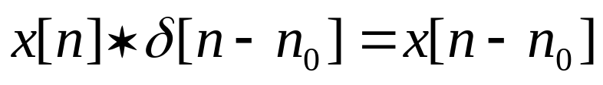
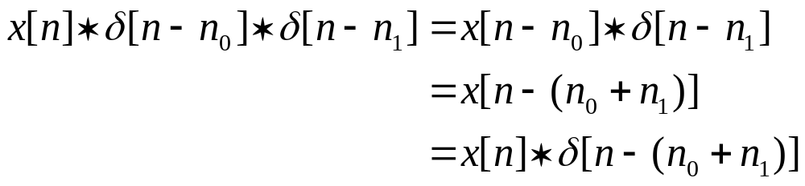
4. The Shifting Property in time domain （时移特性 ）
h[n]
x[n]
y[n]
considering the cascaded time shifting system:
δ[n-n₀]
δ[n-n₁]
x[n]
y[n]

Slide 21
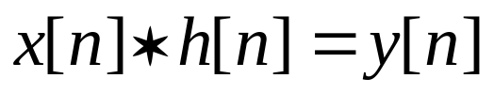
For a DT LTI system:
h[n]
x[n]
y[n]
δ[n-n₀]
x[n-n₀]
h[n]
x[n]
y[n-n₀]

Slide 22

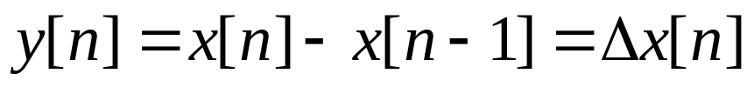
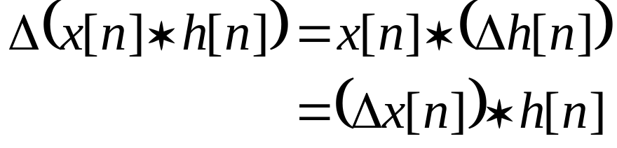
5. The Difference Property of Convolution Sum （卷积和的差分特性 ）
Δ
x[n]
y[n]=x[n]-x[n-1]
Considering the difference of the convolution sum of x[n] and h[n],
h[n]
Δ
x[n]
Using the associative property, one obtain

Slide 23
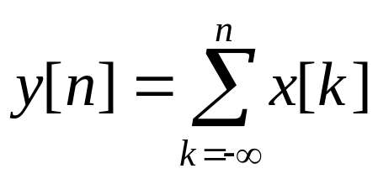

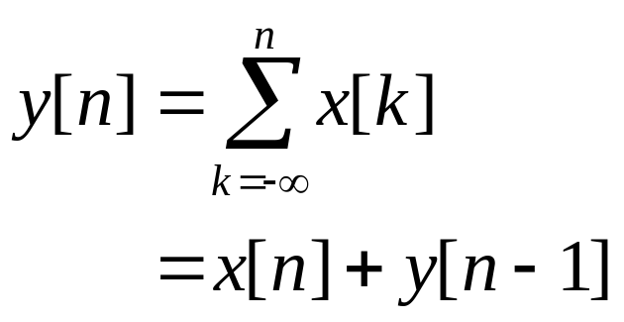
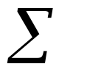
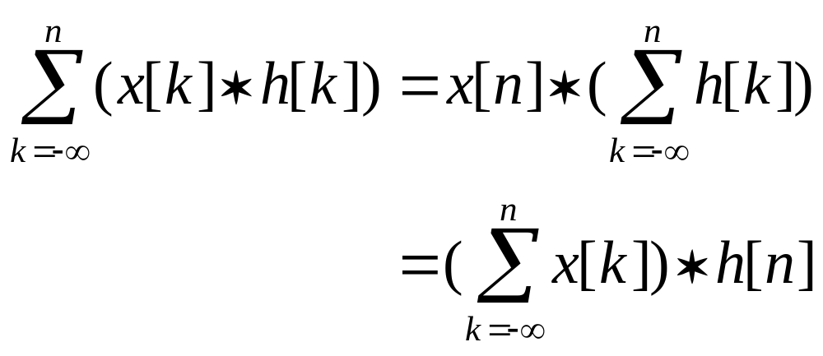
6. The Accumulation Property of Convolution Sum （卷积和的累加特性 ）
x[n]
Considering the accumulation of the convolution sum of x[n] and h[n],
h[n]
x[n]
Using the associative property, one obtain

Slide 24


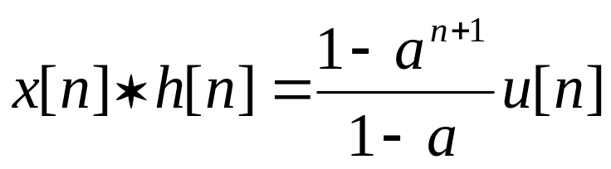
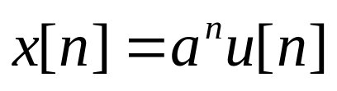
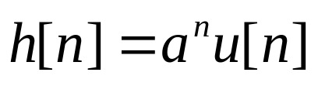
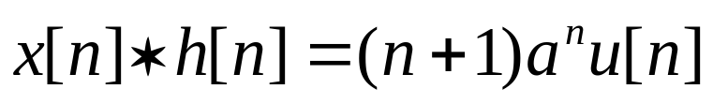
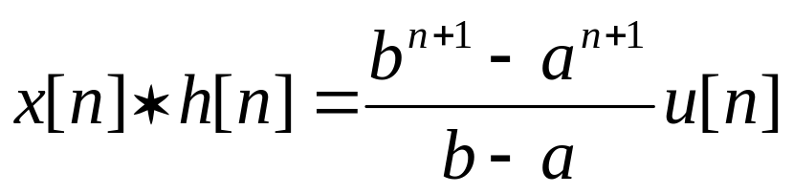
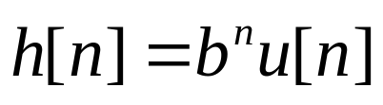
Example： Calculate the following typical convolution sum x[n]*h[n]:

Slide 25
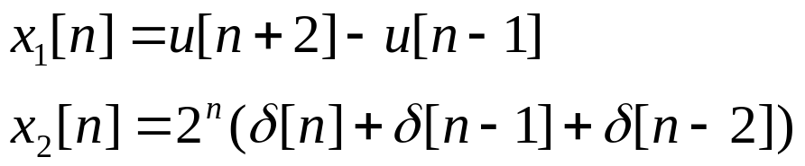

Example:
Let
Determine

Slide 26
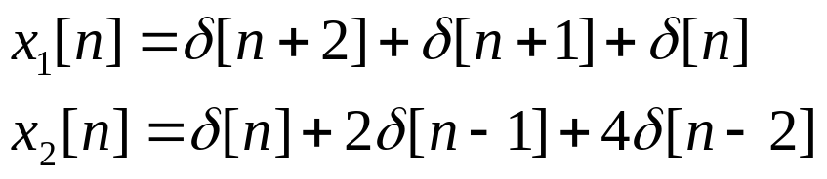
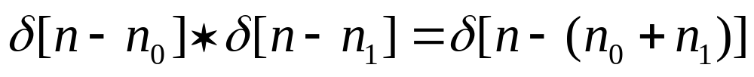
Solution:
Using the sampling property

Slide 27
Example:
Let
Determine

Slide 28
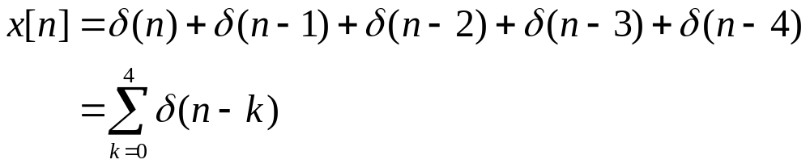
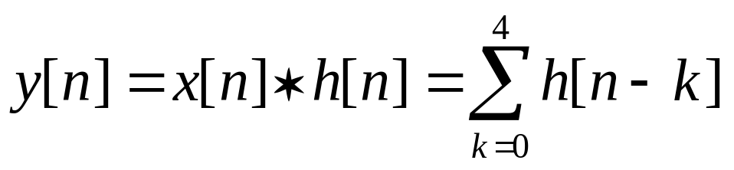
Solution 1:
Using
One obtains

Slide 29

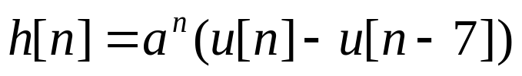
Solution 2:
Using
One obtains

Slide 30
Outline of the Chapter
2.1 DT LTI Systems: the Convolution Sum
2.2 CT LTI Systems: the Convolution Integral
2.3 Properties of LTI Systems
2.4 Casual LTI Systems in terms of
Differential/Difference Equations
2.5 Singularity Functions

Slide 31
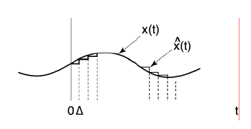
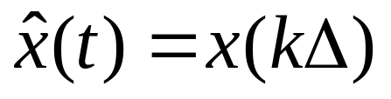
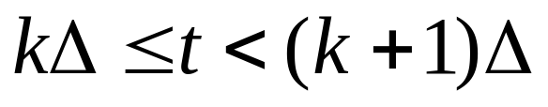
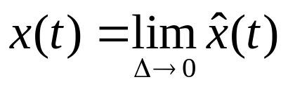
2.2.1 The Representation of CT Signals in Terms of Impulses
Approximate a CT signal x(t) as a sum of shifted, scaled
pulses
Let
for
Then if Δ is sufficient small, it could exactly represent x(t)

Slide 32
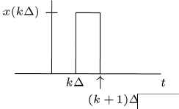
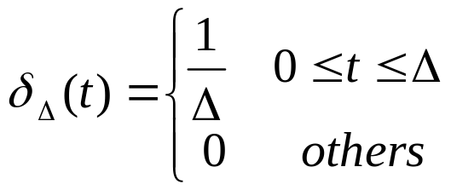
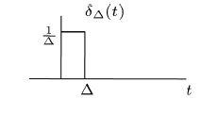
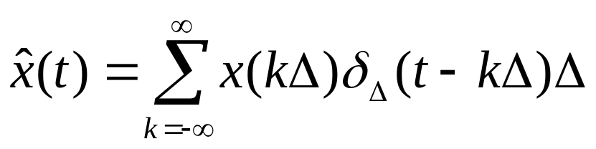
Recall
for
Define
One obtains

Slide 33
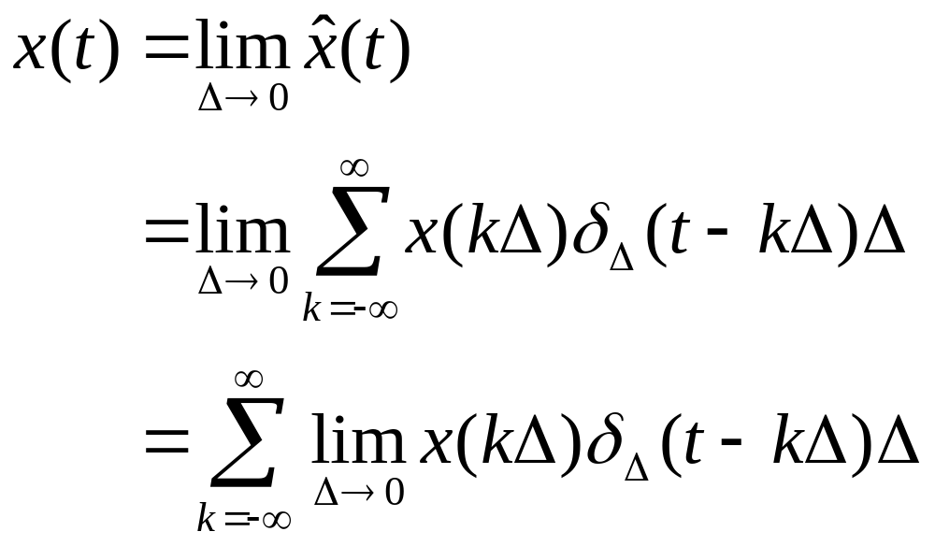
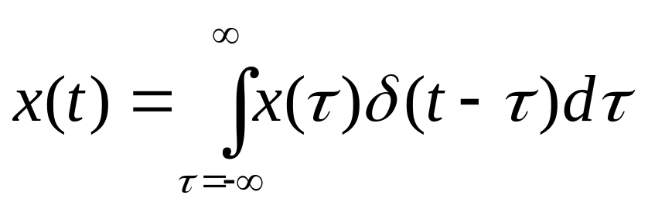
Recall
Basic Signals
x(t) could be represented by a integral of shifted unit impulse δ(t-τ), with weights of x(τ)

Slide 34


2.2.2 Convolution Integral Representation of LTI Systems
CT LTI System
x(t)
y(t)
  1. For a LTI system with the response of h(t) to the unit impulse δ(t)
—— Unit Impulse Response
Time-invariance allows

Slide 35



CT LTI System
x(t)
y(t)
Considering the weighted integral of delayed impulse representation of x(t)
Superposition allows
——Convolution Integral
That is

Slide 36
Observations
A CT signal could be represented as a linear integral of shifted unit impulse δ(t-τ), with weights of x(τ).
The response y(t) to an input CT signal x(t) of a LTI system is the weighted linear integral of shifted unit impulse response, weighted by x(τ) for the delayed impulse response of h(t-τ).
A LTI system is completely characterized by its response to the unit impulse ---- h(t)
W4.1

Slide 37

2. Convolution Integral

Slide 38


Method 1. Visualizing the calculation of convolution sum graphically
Step 1. Replace t with τ for signals x₁(t) and x₂(t), i.e. τ is the independent variable
Flip
x₂(τ) -> x₂(- τ)
Step 2. Obtain the time reversal of x₂(τ)
Step 3. For the output value at any specific time t, shift x₂(-τ) with offset t to obtain x₂(t-τ)
Shift
X₂(- τ) -> x₂(t- τ)
Step 4. Multiply the two sequences x₁(τ) and x₂t-τ) obtained in Step 1 and Step 3, respectively, and integrate the resulting product from to
Multiply
x₁(τ )x₂(t- τ)
Integrate

Slide 39





Example：
Let
Determine

Slide 40


1)

Slide 41
Method 2. To exploit the property of δ(t) to calculation the convolution integral
Details will be presented later after the study on the properties of convolution and CT LTI systems

Slide 42
2.2.3 Properties of convolution and CT LTI systems. We will focus on
  Understanding the corresponding physical concept of LTI systems to each property of convolution operation;
  Simplifying the convolution calculation by exploiting the properties of these properties of convolution operation

Slide 43


1. The Commutative Property（交换律 ）
2. The Distributive Property（分配律 ）
3. The Associative Property （结合律 ）

Slide 44


4. The Shifting Property in time domain （时移特性 ）
δ(t-t₀)
δ(t-t₁)
x(t)

Slide 45


5. The Differential Property of Convolution Integral（卷积积分的微分特性 ）
h(t)
x(t)

Slide 46


6. The Integration Property of Convolution Integral （卷积积分的累积特性 ）
Considering the integration of the convolution integral of x(t) and h(t),
h(t)
x(t)
Using the associative property, one obtain

Slide 47











Example： Calculate the following typical convolution integral x(t)*h(t):

Slide 48




Example:
Let
Determine

Slide 49

Solution 1: Visualized approach
From the figures, we can find that
when t<-T, or t>T, there has no overlap between x(τ) and h(t-τ), i.e. y(t)=0
when –T<t<T, x(τ) h(t-τ) is a rectangle with amplitude 1 and the overlapped region increases when t increases from –T to 0, and decrease thereafter.
Then for any –T<t<T, after the integration operation, one obtains

Slide 50



Solution 2: Analytical approach
Following the definition of convolution integral, one obtains
for

Slide 51


then
Similarly,

Slide 52

Solution 3: To exploit the property of convolution integral

Slide 53



x(t)
Example:
1
Let
T
t
h(t)
2T
2T
t
Determine

Slide 54





Slide 55



T
T
2T
3T
-T

Slide 56


Question: if x₁(t)=1+x(t), where x(t) is defined in the previous example, how to exploit the differential property to calculate x₁(t)*h(t)

Slide 57
Outline of the Chapter
2.1 DT LTI Systems: the Convolution Sum
2.2 CT LTI Systems: the Convolution Integral
2.3 Properties of LTI Systems
2.4 Casual LTI Systems in terms of
Differential/Difference Equations
2.5 Singularity Functions
W4.2

Slide 58
Question: Since the impulse response could fully characterize an LTI system, how to determine the properties of the system by its impulse response

Slide 59


1. The Commutative Property（交换律 ）
2. The Distributive Property（分配律 ）
3. The Associative Property （结合律 ）

Slide 60




4. LTI Systems w/wo Memory
for t≠0
for n≠0
All CT and DT LTI systems are with memory, except:

Slide 61


5. Invertibility of LTI Systems
The impulse responses of the system and its inverse system satisfy
6. Causality of LTI Systems
For any causal LTI system, its impulse response should satisfy
for t<0
for n<0
and if a LTI system with its impulse response satisfies the above condition, it is a causal system.
i.e. Sufficient and necessary condition
How to prove it?

Slide 62


7. Stability of LTI Systems
The sufficient and necessary condition for a LTI system to be stable is that its impulse response satisfies
Absolutely integrable
Absolutely summable

Slide 63


Slide 64


Slide 65


Slide 66
Outline of the Chapter
2.1 DT LTI Systems: the Convolution Sum
2.2 CT LTI Systems: the Convolution Integral
2.3 Properties of LTI Systems
2.4 Casual LTI Systems in terms of
Differential/Difference Equations
2.5 Singularity Functions

Slide 67


Recall the importance of study of LTI systems:
  with convolution integral/sum method, one can calculate a LTI system response to the system input x(t)/x[n]
  a large number of CT/DT systems can be assumed to be LTI
  For a initial reset （起始松弛）system represented by a linear constant-coefficient differential/difference equation, it also could be regarded as a LTI system.
  However, it should be noticed that only a linear constant-coefficient differential/difference equation cannot specify a continuous-time system uniquely. Other conditions, such as the output and its derivatives at a given time under a given input (initial states) or the statements about linearity, time-invariance, causality and stability, are also required.

Slide 68
In this Section, we will focus on how to determine the complete solution to the input x(t)/x[n] for a system represented by a linear constant-coefficient differential/difference equation with some aforementioned conditions, by solution decomposition into
  Homogeneous Solution (natural response) and Particular Solution (force response)
  Zero-Input Response and Zero-State Response

Slide 69




2.4.1 Approaches to determine the complete solution to the system represented by a linear constant-coefficient differential equation with the input of x(t)
To simplify the notation,
with auxiliary conditions of
for
If the x(t)=0 for t<t₀, y^{(k)}(t₀) is called the initial condition, the system states before the input of the signal, i.e. t₀₋

Slide 70






1. Homogeneous Solution (natural response) and Particular Solution (forced response)
①homogeneous solution (齐次解): satisfies
Determine the characteristic values of
as
  if all α_{i} are the characteristic values of order 1, (单根)

Slide 71



  b. if there are r different characteristic values α_{i} , each with the order of σ_{i} (r个σ_{i}重根α_{i})
  Notes：
  1. the coefficients A_{i} or A_{ik} should be determined by the auxiliary conditions simultaneously with those in the particular solution, since the condition is the auxiliary condition to determined the overall input-output relationship .
  2. In the following of this Section, we consider the initial condition when dealing with systems represented by differential equations. More specifically, in the other parts of this course, we assume the system is initial rest, i.e.
  3. When the signal is fed into a system at t=0, the system states at 0₊ may be same as those at 0₋, may be different. It is up to the property of the input

Slide 72








② particular solution (特解)
For any input signal x(t), we can get f(t) as
Then for y_{p}(t) is in the following forms corresponding to different forms of f(t)
f(t)
Corresponding form of particular solution
(Constant input is a special case with p=0)
α is not the characteristic value
α is the characteristic value with order 1
α is the characteristic value with order k

Slide 73


③ Determine coefficients in
Coefficients in the particular solution: substituting y_{p}(t) in the equation
we can obtain all the coefficients in the particular solution, except for those items associated with , where α is the characteristic value
2. Other coefficients: substituting the complete solution in the initial conditions,
Then all coefficients in the complete solution are obtained
for
Notes：
1. The particular solution of a system is fully determined by the input signal;
2. As for the homogeneous solution, the form only determined by the system itself, the input signal will show its impact on the coefficients in solution

Slide 74




Example:
（1）
Solution:
then
and
Substituting y_{p}(t) in (1)
Case 0: y(0+)=1
Case 1: y(1) =1
Case 2; y(0-) =1
Case 3: y(-1) =1

Slide 75


Exercise :
Notes：
The characteristic values are -1,-2, all with order 1,
The input is
Notes:
2e^(-t)-2e^(-2t)+te^(-t), for t>0

Slide 76


Example:
（1）
a)
b)
Hints 1:
To calculate the particular solution and homogeneous solution in different continuous region of the input signal
Hints 2:
From the LCCDE, we can find that for input a) and b), the output and the 1st order differentiation of the output is continuous at the disrupt point of the signal.
the output value at 0⁻ or 0⁺
W5.1
Notes:
y1=0.5(1-e^(-2t))) when t>=0; and 0, when t<0
y2= 0.5(1-e^(-2t))) when t>=-1;
0.5(1-e^2)e^(-2(t+1)), when t<-1

Slide 77


2. Zero-input response and Zero-states response
① zero-input response (零输入响应)
—— system response to the non-zero initial states
—— the response is part of homogeneous solution
E.g.：in case all the characteristic values are of order 1 (所有特征根为单根)：
A_{zik} could be determined by the initial states/conditions

Slide 78



②zero-states response (零状态响应)
—— system response to the external input
—— the response includes part of the homogenous solution and particular solution
E.g.：in case all the characteristic values are of order 1 (所有特征根为单根)：
A_{zsk} could be determined by the states changes at time 0, i.e.

Slide 79

③ Complete solution
Homogeneous solution
Particular solution
Notes: the natural response includes
zero-input response and
part of zero-state response

Slide 80
④ Linearity properties of zero-input and zero-state responses
Zero-state response is linear with the input
Zero-input response is linear with the initial state
y_{zi}(t)
x(t)=0,
T<0
CT Causal LTI System
y_{zs}(t)
y(t)
Notes：when not initial rest, the complete solution of the system is not linear with the input.
If the system is initial rest, i.e. zero initial conditions, the system is LTI,
Otherwise it is an incrementally linear time-invariant systems

Slide 81










Example：
u(t)
Solution:

Slide 82












Slide 83


Exercises：
For a LTI system, the input x(t) satisfies x(t)=0 for t<0, under the same initial conditions, we have
1, the overall system response to x(t) is , for t>0
2, the overall system response to 2x(t) is , for t>0
To determine the overall system response to 4x(t) with the same initial conditions

Slide 84

For zero-input response:
—Classical approach：to calculate the homogeneous solution (part)
For zero-state response
——Traditional approach：to calculate the particular solution and homogeneous solution(part)
—— Convolution integral approach：
—— Transform domain approaches： Fourier transform (frequency domain), Laplace transform (s-domain), …

Slide 85



3. Transient response to steady state response
Transient response: the part of the response approaching to 0,
when
Steady state response: the non-zero part of the response,
when
Example:

Slide 86

2.4.2 Approaches to determine the complete solution to the system represented by a linear constant-coefficient difference equation with the input of x[n]
1. Iterative approach
2. Time domain approaches
Homogeneous response + particular response
zero-input and zero-status responses
transient response and steady state response

Slide 87





1. Iterative approach
Example:
when n<0
。。。
Notes: Simple, but difficult to obtain the close-form response

Slide 88



2. Time domain approach
1．Homogeneous solution + particular solution /
Natural response + forced response
① homogeneous solution (齐次解)
Determine the characteristic values of
as
  if all α_{i} are the characteristic values of order 1, (单根)

Slide 89

  b. if there are r different characteristic values α_{i} , each with the order of σ_{i} (r个σ_{i}重根α_{i})
  Notes：
  the coefficients c_{i} or c_{ik} should be determined by the auxiliary conditions simultaneously with those in the particular solution, since the condition is the auxiliary condition to determined the overall input-output relationship .

Slide 90












② particular solution (特解)
For any input signal x(t), we can get f[n] as
Then for y_{p}[n] is in the following forms corresponding to different forms of f[n]
f[n]
Corresponding form of particular solution
No characteristic value equals to 1
with characteristic value 1 of order r
No characteristic value equals to α
with characteristic value α of order 1
with characteristic value α of order r
No characteristic value equals to

Slide 91






③ complete Solution
Example:
①Homogeneous Solution

Slide 92





② particular solution
Substituting
in the right-side of the difference equation, the right-side of the equation becomes
Let
And substituting it in the difference equation to determine the coefficients B₁ and B₂
So

Slide 93




③ Complete Solution
With the condition that
Natural
Forced

Slide 94
As to the auxiliary conditions
When the input signal is fed into the system at n=n_{0,} define initial conditions and start condition as
Initial Conditions/States （起始条件）: the system states before the signal is fed into the system, {y[n₀-1], y[n₀-2],…, y[n₀-N]}
Start Conditions/States （初始条件）: the first N states after the signal is fed into the system, {y[n₀], y[n₀+1],…, y[n₀+N-1]}
Notes: For DT systems, we can obtain the start condition from the initial condition by means of “iterative approach”

Slide 95


2．Zero-input and zero-state responses
① Zero-input response
Example: when α_{k} is the characteristic value with order 1
c_{zik} is determined by the initial conditions
② Zero-state response
Example: when α_{k} is the characteristic value with order 1
c_{zsk} is determined by the start conditions {y[n₀], y[n₀+1],…, y[n₀+N-1]} of the ZS response, where n0 is the start time, i.e. the time the input x[n] is fed into the system.

Slide 96

③
Notes: Natural response (homogeneous response) includes the zero-input response and
part of the zero-state response

Slide 97






Example:
Soulution:
(1)

Slide 98







(2)
Substituting the particular solution
in the difference equation
For zero-state response, the initial states are 0!
i.e. the system states before the input is fed into the system are 0!

Slide 99


Slide 100
④ Linearity properties of zero-input and zero-state responses
Zero-state response is linear with the input
Zero-input response is linear with the initial state
Y_{zi}[n]
X[n]=0,
n<0
CT Causal LTI System
Y_{zs}[n]
Y[n]

Slide 101



Example:
Determine
1. Natural response and forced response
2. Zero-input and zero-state responses
Hints: You may first calculate the zero-state response for x[n], then that for x[n-2]

Slide 102


Special case: to determine h[n] for a system represented by difference equations
Since h[n] is the zero-state response to the input of δ[n], the problem is equivalent to calculate the zero-state response of the system with initial conditions and input of
?
is the characteristic value with order 3

Slide 103


Notes: the coefficients could be determined by the start conditions after the impulse

Slide 104



3. Transient response to steady state response
Examples:

Slide 105
Till now, we have discussed 2 system description methods in time domain
1. h(t)/h[n]
h(t)/h[n] could sufficiently describe a LTI system
is the zero-state response of the system
2. Differential/difference equations
A differential/difference equation cannot fully describe a LTI system, it needs some auxiliary conditions
Under certain conditions, one could obtain complete response of the system
Notes: in the later of this course, we focus on the causal LTI systems, i.e. systems represented by difference/differential equations with initial rest conditions。

Slide 106


2.4.3 Block Diagram Representations of First-Order Systems Described by Differential and Difference Equations
1.
b
+
x(n)
y(n)
D
-a
3 basic elements in block diagram:
adder(加法器),
multiplier/amplifier(常系数乘法器),
unit delayer(单位延时器)

Slide 107




2.
b
y(t)
+
x(t)
For CT systems, we prefer to use integrator rather than differentiator, because the later isn’t robust to interference in circuit design
-a
3 basic elements in block diagram:
adder(加法器),
multiplier/amplifier(常系数乘法器),
integrator(积分器)

Slide 108









Example：
To describe the following system in the form of constant-coefficient difference equation
+
+
x(t)
y(t)

Slide 109



Slide 110
Outline of the Chapter
2.1 DT LTI Systems: the Convolution Sum
2.2 CT LTI Systems: the Convolution Integral
2.3 Properties of LTI Systems
2.4 Casual LTI Systems in terms of
Differential/Difference Equations
2.5 Singularity Functions

Slide 111

The Operational Definition of the Unit Impulse δ(t)
δ(t) —idealization of a unit-area pulse that is so short that, for
any physical systems of interest to us, the system responds
only to the area of the pulse and is insensitive to its duration
Operationally:The unit impulse is the signal which when
applied to any LTI system results in an output equal to the
impulse response of the system. That is,
δ(t) is defined by what it does under convolution.

Slide 112

Using the definition of δ(t) in terms of convolution, one obtains the following properties of the singular function δ(t):
  δ(t)*δ(t)=δ(t), δ(t-t₀)*δ(t)=δ(t-t₀)
  When x(t)=1, one obtains
  x(t)*δ(t)=1, then we can come to conclusion that δ(t) has unit area as defined in terms of Dirac function
  Definition in terms of integral (sampling property)

Slide 113



The Unit Doublet (单位冲激偶)—Differentiator
Impulse response = unit doublet
The operational definition of the unit doublet:

Slide 114


Triplets and beyond!
n is number of
differentiations
Operational definitions

Slide 115




Integrators
Impulse response:
“-1 derivatives" = integral ⇒I.R.= unit step
Operational definition:
Cascade of n integrators :
n times

Slide 116



Integrators (continued)
More generally, for n>0

Slide 117



Notation
Define
Then
m and n can be any integer
E.g.

Slide 118

Sometimes Useful Tricks
Differentiate first, then convolve, then integrate

Slide 119





Example

Slide 120


Example (continued)

Slide 121
Homework (Due W7_D2)
  BASIC PROBLEMS WITH ANSWER: 2.1, 2.4, 2.8, 2.11, 2.19
  BASIC PROBLEMS: 2.24, 2.40, 2.46, 2.32, 2.33

Slide 122
Summary
2.1 DT LTI Systems: the Convolution Sum
2.2 CT LTI Systems: the Convolution Integral
2.3 Properties of LTI Systems
2.4 Casual LTI Systems in terms of
Differential/Difference Equations
2.5 Singularity Functions

